Slide 1
Git training.
28 of July 2021
By Luisa Pinto
www.footasylum.com

Slide 2
Learning roadmap.
Fundamentals (10.30am-12.30pm)
Version control systems
What is Git
Creating a Git repository
Tracking file changes with Git
Advanced Git (1.30pm-3.30pm)
Branching
Merging
Rebasing
www.footasylum.com
Notes:
Version control systems, such as Git, were created to track changes in source code. However, it can be used to track any type of file.
Typical operations supported by a VCS
rollback specific files to a previous state,
rollback an entire project to a previous state,
compare differences over time,
identify who modified a file,
determine when and by whom an issue was introduced,
easily recover deleted or corrupted files.

Slide 3
What is a version control system?
www.footasylum.com
Notes:
Right Team, I have just said "version control" which as the name indicates is about controlling versions! So just invert the words “version control” to “control version”. Meaning that a Version Control System is just software that helps you to control (or manage) the different versions of something (typically source code).

Slide 4

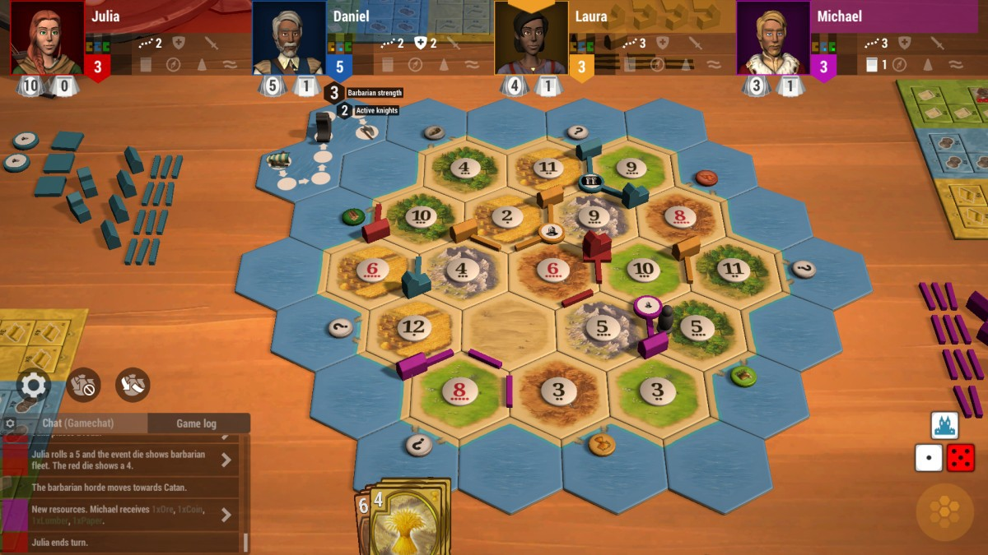
Real-life version control system.
Article: medium.com/@bsurmen/version-control-system-999b56eb2120
www.footasylum.com
Notes:
Right Team, I have just said "version control" which as the name indicates is about controlling versions! So just invert the words “version control” to “control version”. Meaning that a Version Control System is just software that helps you to control (or manage) the different versions of something (typically source code).

Slide 5
What can we do with version control systems?
Track
Rollback
Compare
Identify
Blame
Recover
www.footasylum.com
Notes:
Version control systems were created to track changes in source code. That is a VCS allows us to track changes in directories and files. A VCS should also allow a user to rollback a file, a directory, or an entire project to a previous state, and to easily recover deleted or corrupted files. Other functions provided by a VCS include but are not limited to support for comparing and navigating the differences between files over time, identify who modified a file and determine when and by whom an issue was introduced.

Slide 6
Version Control System = VCS.
Source Code Management = SCM.
www.footasylum.com
Notes:
For the sake of clarity note that from now onwards we will now be referring to version control system simply as VCS.
You may also find the same concept written down as Source Code Management which in turn is often simply referred as SCM.
In this workshop I am going to stick to VCS.

Slide 7
VCS examples.
Git
https://git-scm.com/
Subversion
https://subversion.apache.org/
Mercurial
https://www.mercurial-scm.org/
www.footasylum.com
Notes:
There are several Version Control Systems out there, which alone proves that version control is incredibly important. Three of the most popular version control systems are:
Git
Subversion
Mercurial

Slide 8
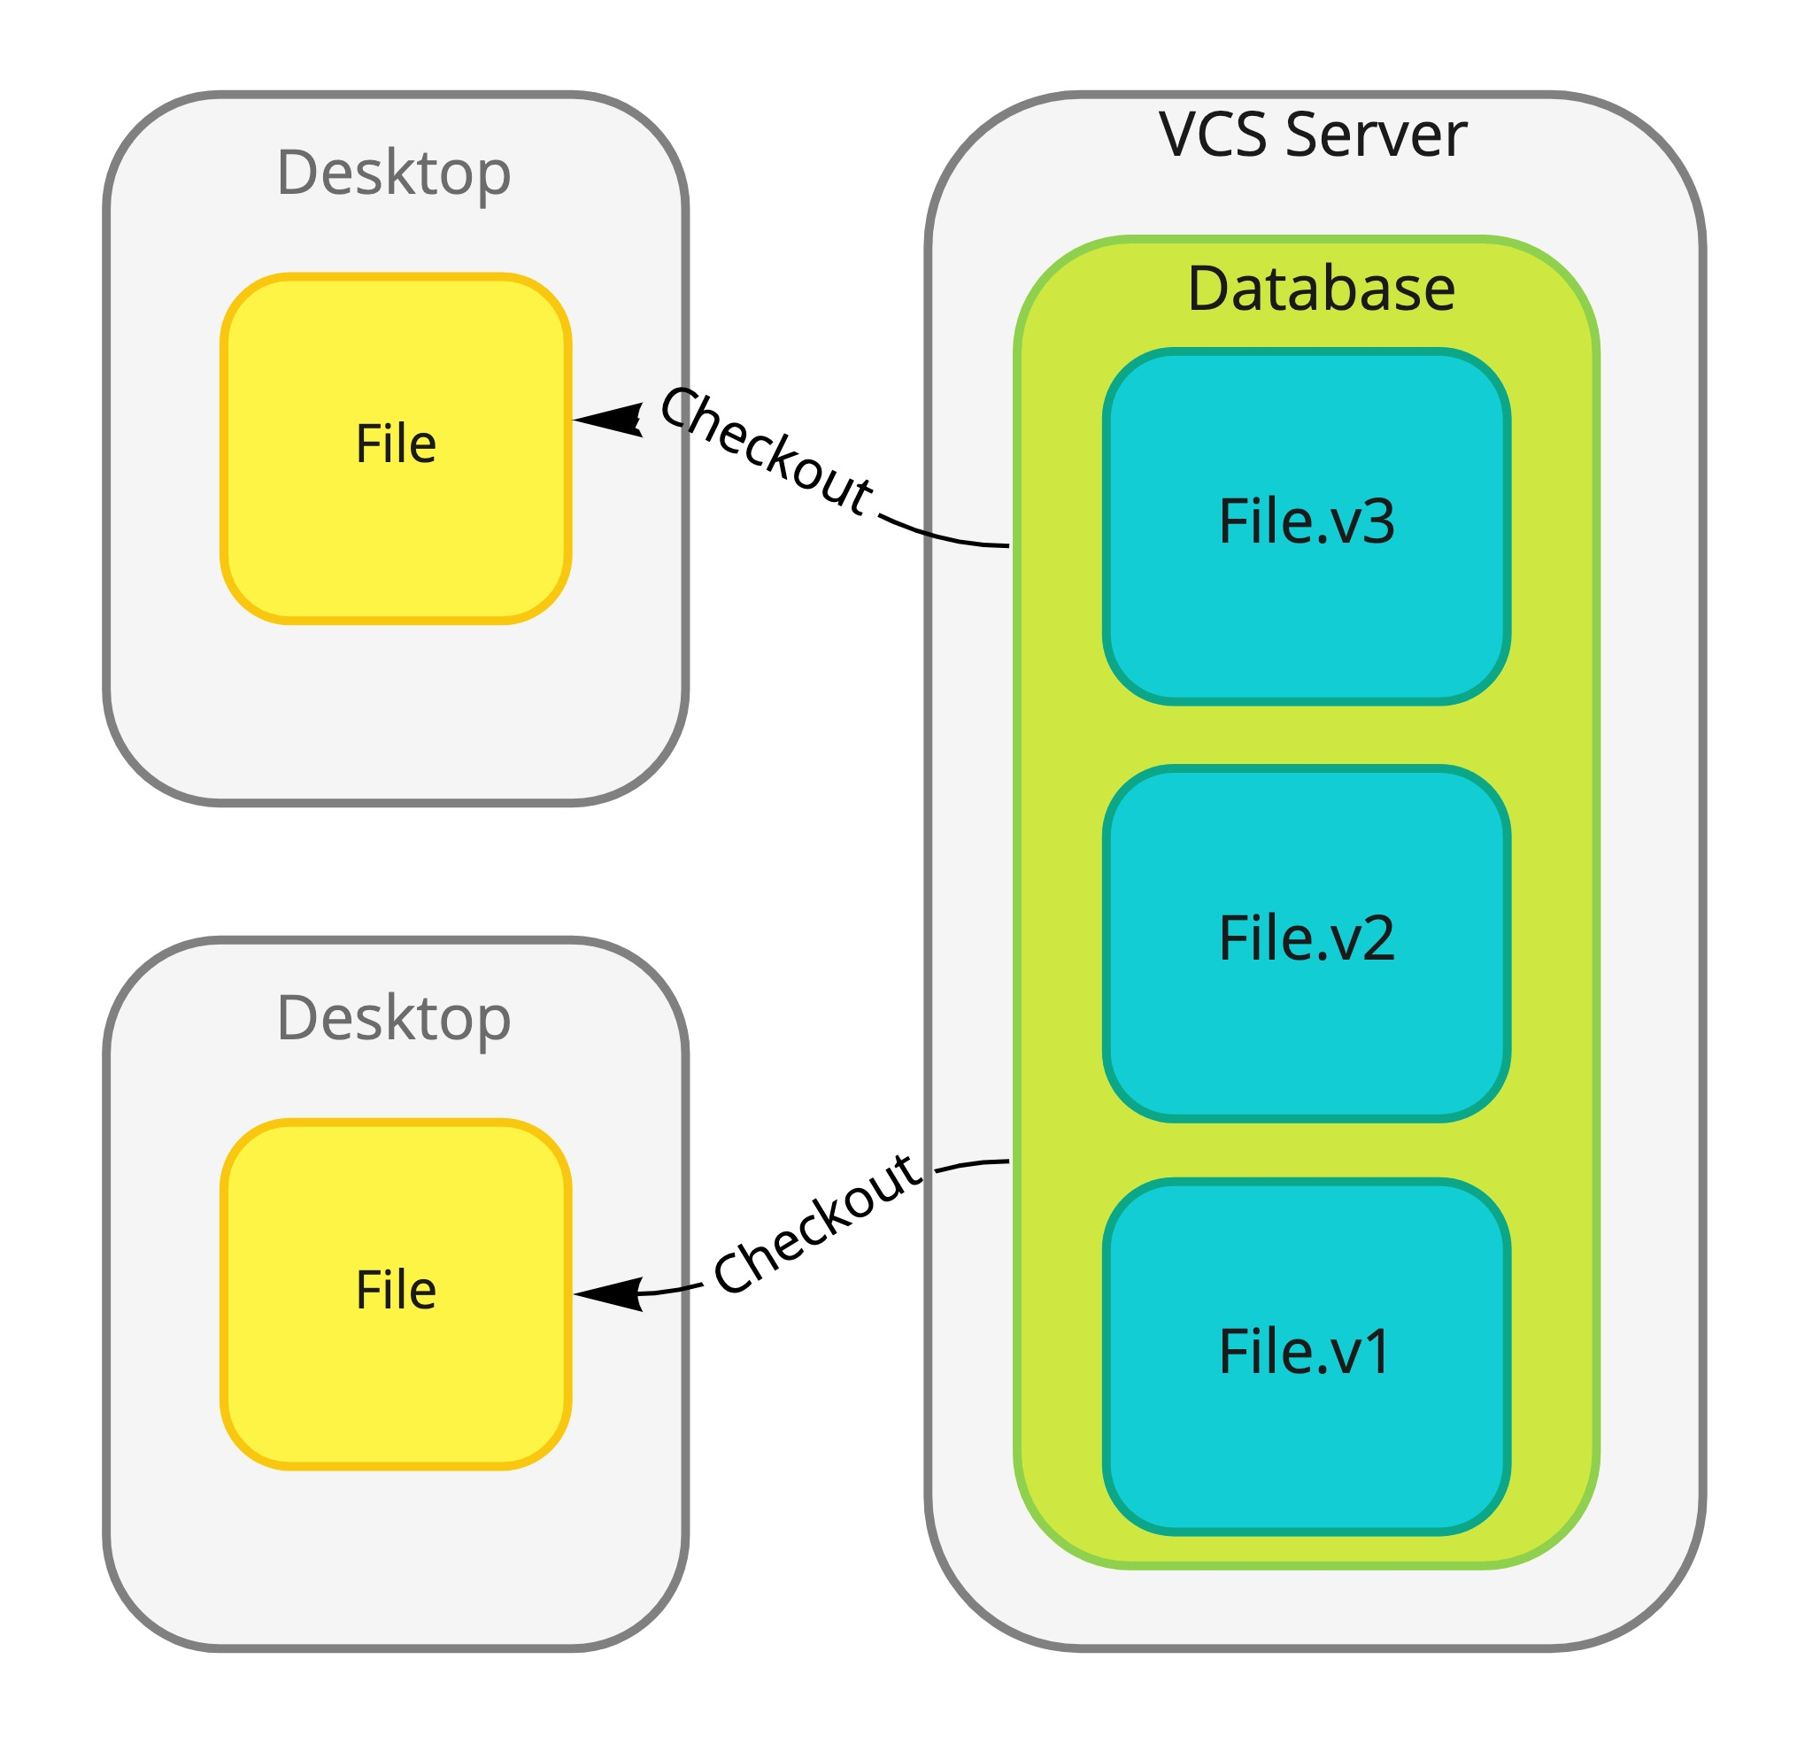
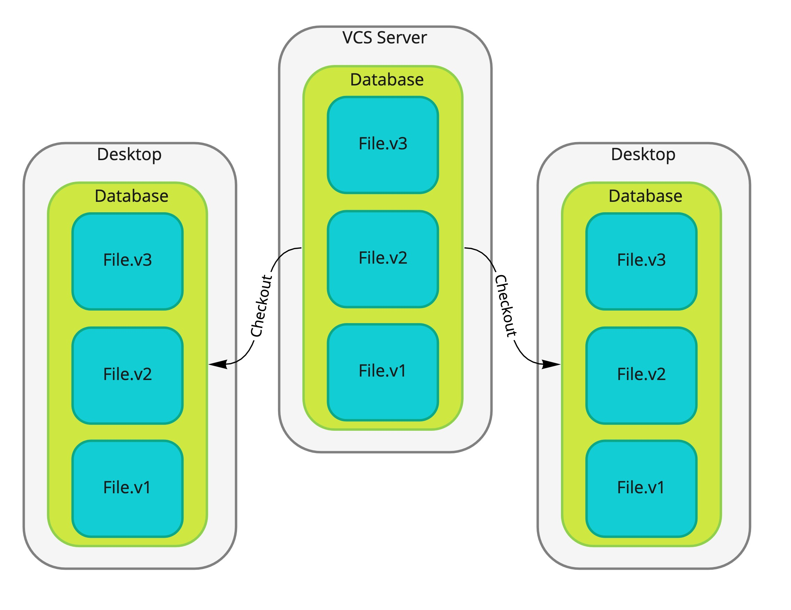
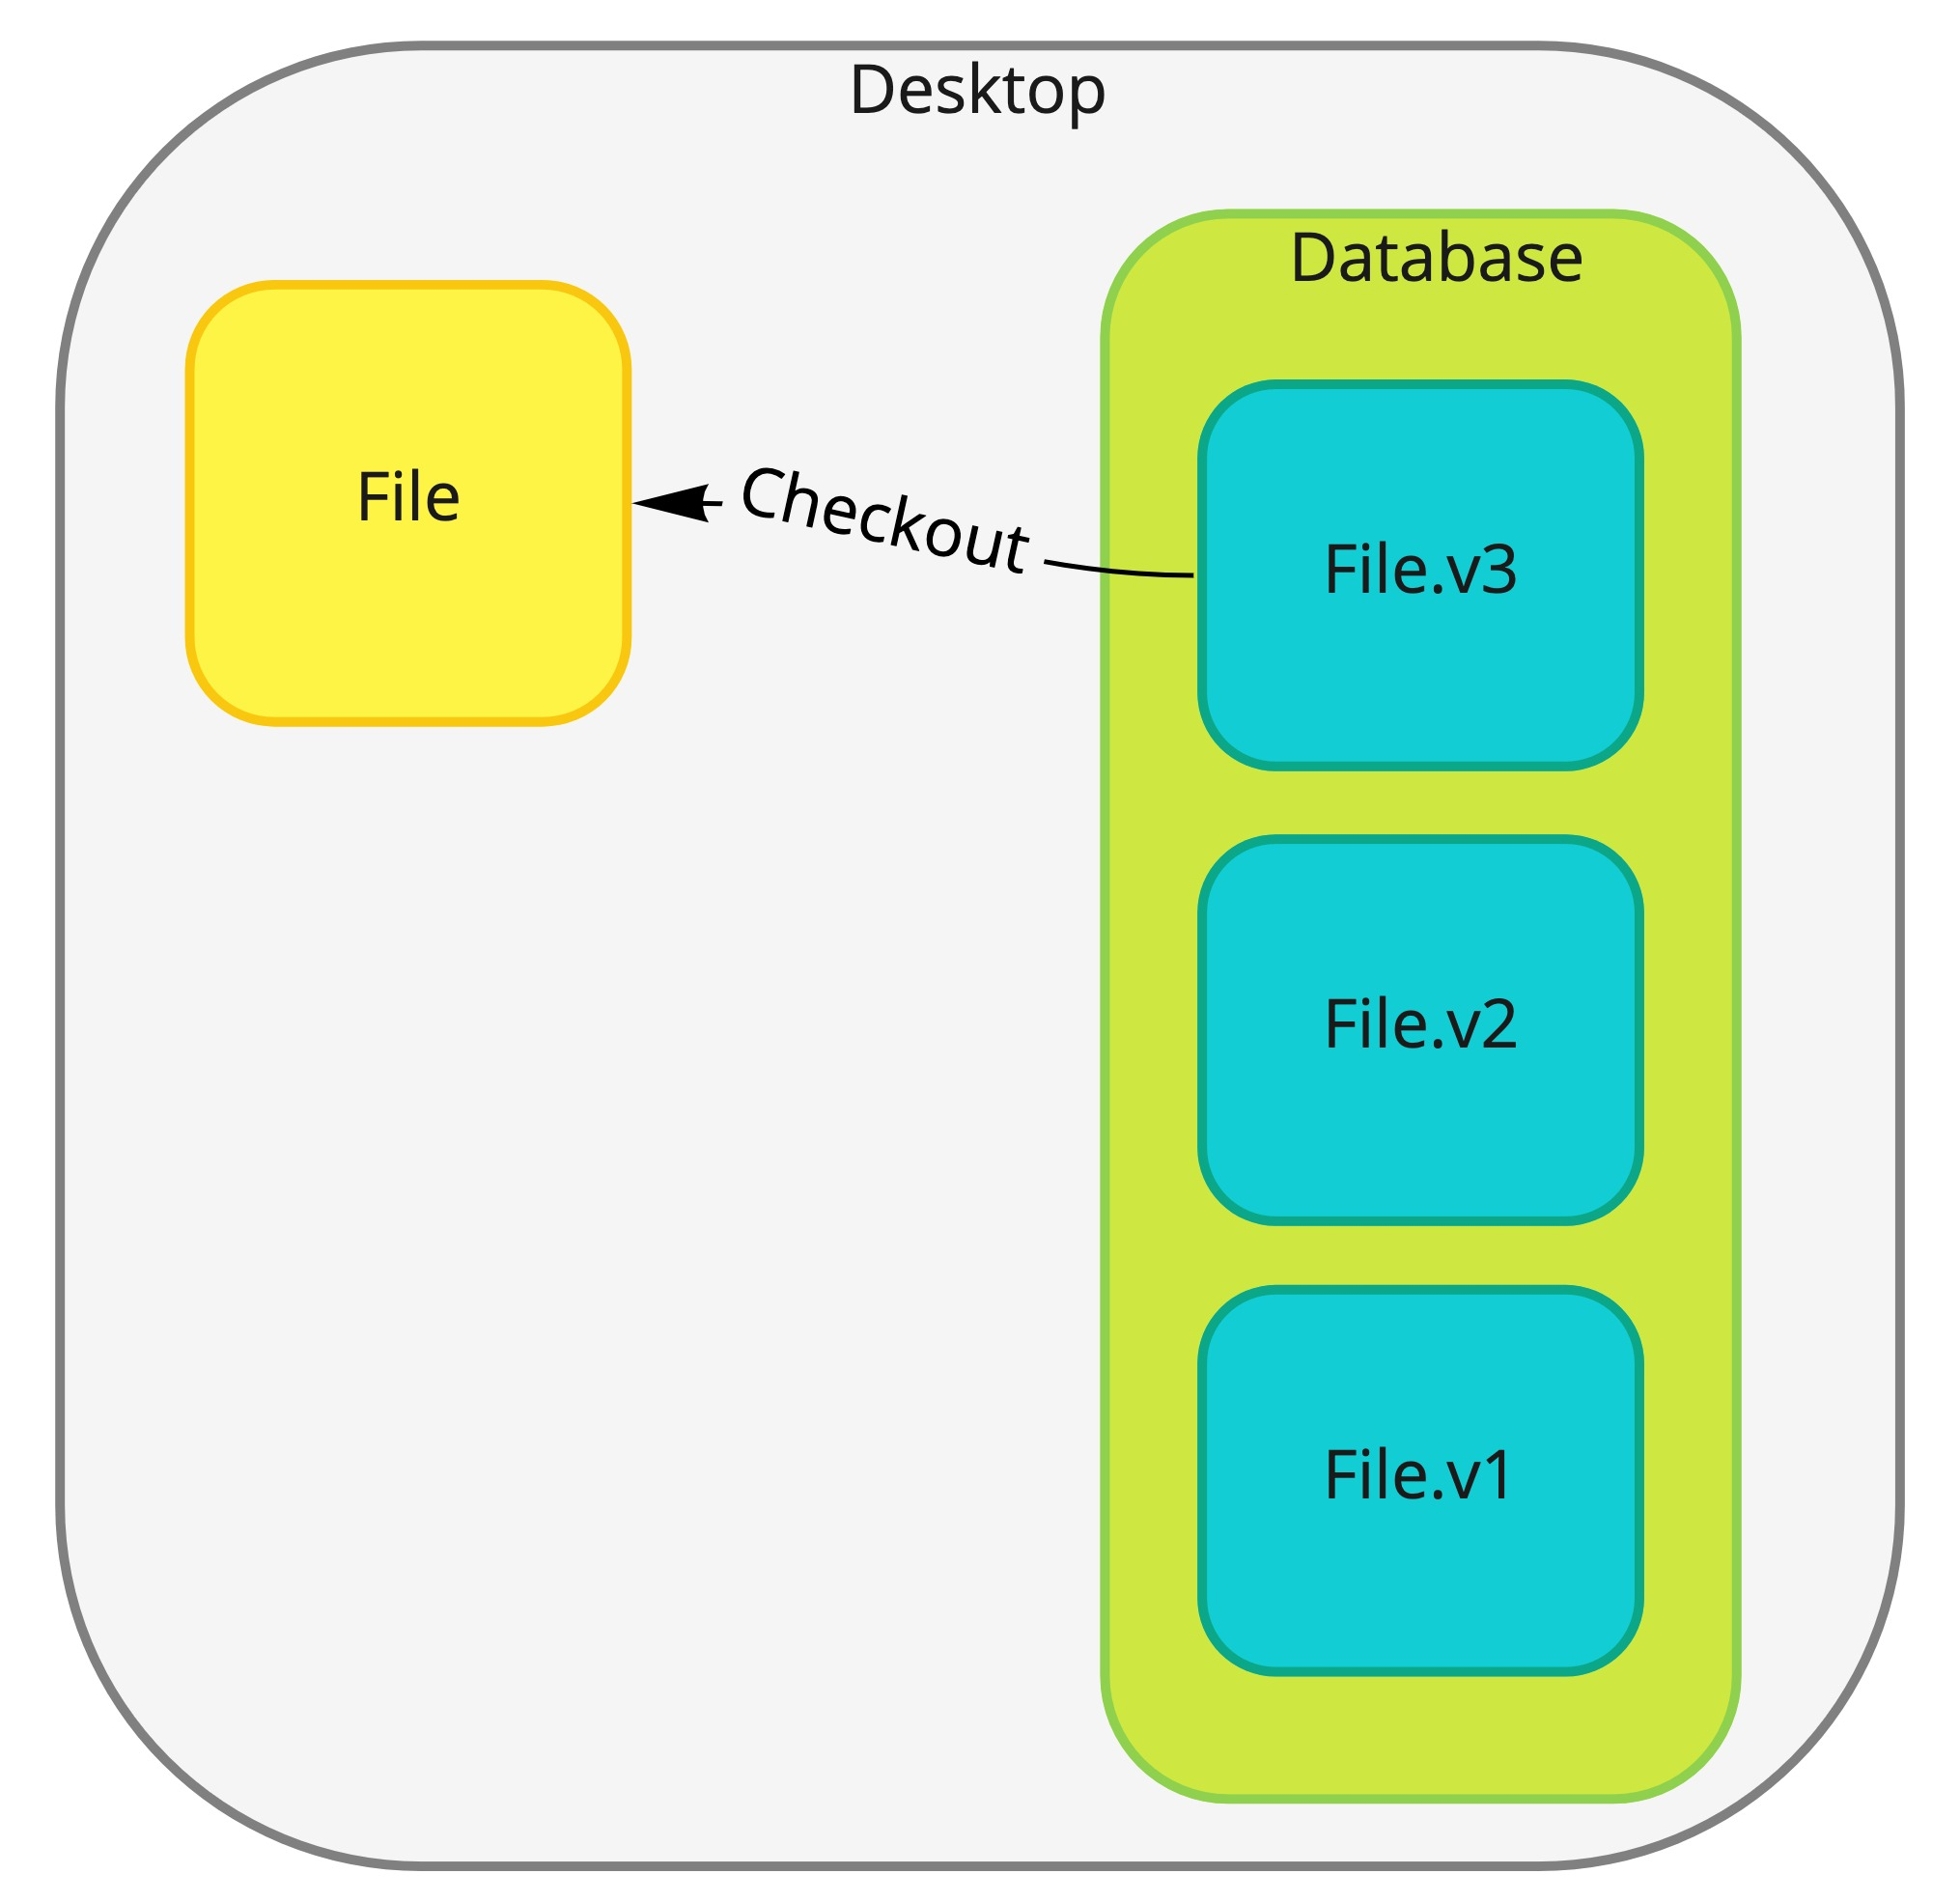
VCS models.
Centralized
Distributed
Local
www.footasylum.com
Notes:
Version control systems evolved over time from Local to Centralized or Distributed. There are therefore three types of version control system models…
the local model - one user with a local repository
the centralized model - all users connect to a central, master repository
the distributed model - each user has the entire repository on their computer
Next, we are going to look at each of these models individually.

Slide 9
Localized Model.
Technique #1
Technique #1
Simple local database
Store all versions of one file
Technique #2
Store differences between files
Recreate on demand
www.footasylum.com
Notes:
Localized VCSs were created in order to solve manual versioning issues. There are two main techniques to implement a localized version control system.
The first technique consists of a VCS comprising one simple local database that stores all versions of a file. The second technique comprises a database that stores only the differences between the versions of a file, recreating a file on demand from the differences store.
These type of systems still exist. One example is the built-in VCS provided by Microsoft Word. Another example is the command tool Diff that is built-in in any Mac OS system, and that is available from the terminal.
An obvious limitation of a Localized system is that it is neither portable nor collaborative.

Slide 10
Centralized Model.
Technique
VCS Server with whole version history and multiple clients connect to the server to checkout from or save changes into the server.
www.footasylum.com
Notes:
Centralized VCS emerged with collaboration at heart. A centralized VCS comprises a server containing the whole history of versions of directories and files being tracked by the VCS.
Multiple clients can connect to the VCS server to download the latest snapshot of the versioned directories and files. This operation is called “checkout” – that is, to download the latest snapshot of the versioned directories and files. Clients then modify files locally and then they save changes in the server.

Slide 11
Centralized Model
Advantages.
Awareness of each others work.
Permissions administration.
Administrate one server vs several local databases.
www.footasylum.com
Notes:
As clients can only to save their changes in the server, it is easier for others to be more often aware of what others are doing. In a VCS system it is often easier to administrate permissions for each user. Another advantage compared is that it is easier to administrate only one server, than keeping up with several instances of local databases.

Slide 12
Centralized Model
Disadvantages.
Developers must connect to server for updating or saving changes.
Clients only checkout latest snapshot of the versioned files.
Clients do not checkout full history.
Single point of failure → Total loss is a possibility ➔ Proper backups are required.
www.footasylum.com
Notes:
One major downside of the centralized VCS model is that if the connection to the server drops, then no one can save changes into the server. And equally no one can navigate over the history of the versioned files, as this is only located in the server itself. Because the whole version history lives only in one server, major care must be taken to ensure to ensure that backups of the server are up to date should for some reason the server be corrupted or totally lost.

Slide 13
Centralized VCS Examples.
CVS
http://cvs.nongnu.org/
Subversion
https://subversion.apache.org/
Perforce
https://www.perforce.com/solutions/version-control
www.footasylum.com
Notes:
CVS, Subversion, and Perforce are examples of centralised version control systems. In this workshop we will not be using a centralized VCS. However, it is important to note that they exist. The links are for those that are more curious and will want to have a further look at them after this workshop.

Slide 14
Please bear in mind that whenever you have the entire history of the project in a single location, you are at a very high risk of losing everything.
www.footasylum.com

Slide 15
Distributed VCS Model.
Technique
Clients fully mirror the serve, checking out the latest snapshot plus the whole history of the versioned files.
Clients modify and save changes locally without the need for a connection to the server.
Notes:
Distributed VCS model also comprises a server containing the latest snapshot and the whole history of the versioned files. However, contrary to what happens in a Centralized VCS, clients of a centralized VCS checkout not only the latest snapshot of the versioned files, but also the whole history of the versioned files. This means that each client is a complete clone of the server. Since each client is a clone of the server, it can update the history of version files locally without the need to connect to the server. On the other hand, since clients do not need to be connected to the server, it is not possible to know what other users have already worked on unless they push their version of the whole history to server, which can happen after several versions have been saved locally.

Slide 16
Distributed Model
Advantages.
Work offline.
Recover server by cloning from client with most recent checkout.
Support for several remote repositories.
Collaboration between several teams in one project.
Extend workflows
www.footasylum.com
Notes:
Remind yourself that in a distributed VCS each client is a complete clone of the server, which means that it is possible to completely recover the server by cloning from the client which has performed the most recent checkout. That is multiple copies of the source code are owned across clients, which eliminates reliance on a single backup. Servers with distributed VCS can usually support several remote repositories which promotes collaboration with different teams within one project and extend workflows such as hierarchical models. Branching and merging can happen automatically and quickly, which increases developer productivity. As all changes are saved locally it is usually faster to complete a cycle of “checkout, commit, check-in”.

Slide 17
Distributed Model
Disadvantages.
Slow initial checkout.
Lack of locking mechanisms.
Additional storage per client.
Increased source code exposure.
www.footasylum.com
Notes:
Initial checkout of a repository is slower as compared to checkout in a centralized version control system, because all branches and revision history are copied to the local machine by default. The lack of locking mechanisms that is part of most centralized VCS and still plays an important role when it comes to non-mergeable binary files such as graphic assets or too complex single file binary or XML packages (e.g. office documents, PowerBI files, SQL Server Data Tools BI packages, etc.). Additional storage required for every user to have a complete copy of the complete codebase history
Increased exposure of the code base since every participant has a locally vulnerable copy.

Slide 18
Distributed VCS Examples.
Git
https://git-scm.com/
Mercurial
https://www.mercurial-scm.org/
Bazaar
https://bazaar.canonical.com/
www.footasylum.com
Notes:
Git, Mercurial and Bazaar are popular examples of distributed version control systems. Let me remind you again that I will share these slides with you, therefore if you are curious you will be able to visit these links on your own time after this workshop. In this workshop we will learn Git.

Slide 19
A VCS helps keeping a detailed history of a project and enables us to to work on its different versions.
We can see the progress timeline of a project and jump to any point in the timeline to recover data or files.

Slide 20

What is Git?
Version Control System
Free
Open Source
Fast
Distributed
Data Integrity
Scalable
www.footasylum.com
Notes:
Git Goals:
- Speed
- Simple design
- Strong support for non-linear development (thousands of parallel branches)
Fully distributed
Able to handle large projects like the Linux kernel efficiently (speed and data size)
GPLv2 to guarantee your freedom to share and change free software---to make sure the software is free for all its users.
Trademark Protected by Software Freedom Conservancy ("Conservancy")
Git thinks of its data more like a series of snapshots of a miniature filesystem.
With Git, every time you commit, or save the state of your project, Git basically takes a picture of what all your files look like at that moment and stores a reference to that snapshot.
To be efficient, if files have not changed, Git doesn’t store the file again, just a link to the previous identical file it has already stored.
Git thinks about its data more like a stream of snapshots.
Similar operations to other version control systems
Stores snapshots instead of differences
Records whole directory tree changes
Most operations are performed locally
Written in C, Shell Scripts, Perl
SHA-1 hashes revision IDs
Sync via custom git, custom SSH, HTTP/HTTPs, Rsync, Email, Bundles
Source code size of 23MB

Slide 21
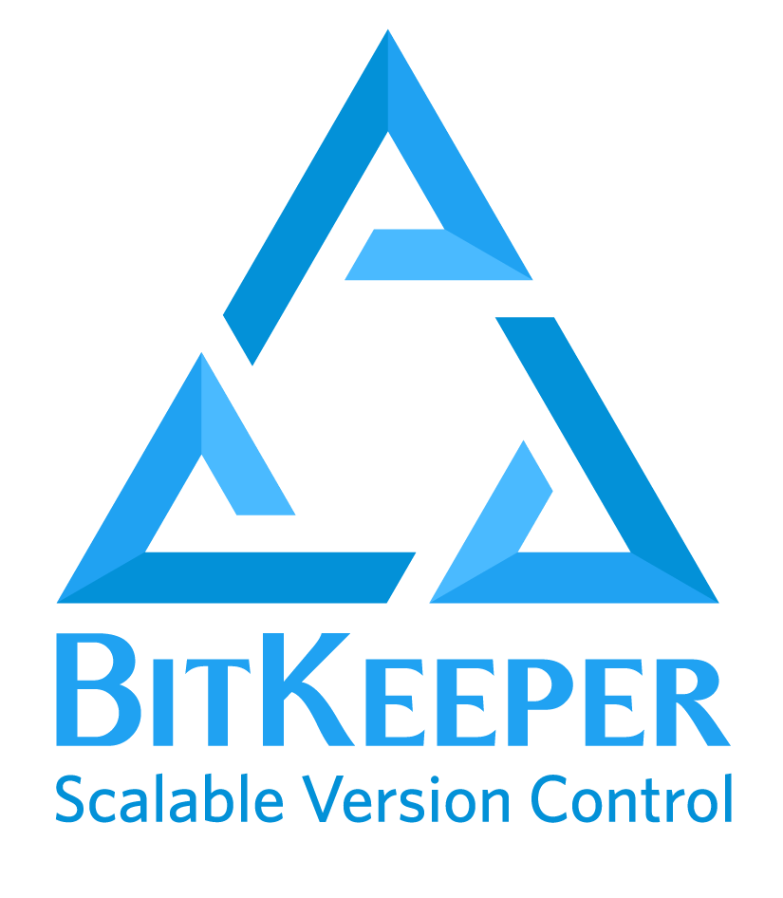

A little bit of history.
1991–2002
Linux kernel distributed as patches and archived files.
2002
Linux kernel source code managed with Bit Keeper, a proprietary distributed version control system.
2005
Bit Keeper became commercial. Linux community began developing Git.
www.footasylum.com
Notes:
Git Goals:
- Speed
- Simple design
- Strong support for non-linear development (thousands of parallel branches)
Fully distributed
Able to handle large projects like the Linux kernel efficiently (speed and data size)
GPLv2 to guarantee your freedom to share and change free software---to make sure the software is free for all its users.
Protected by Software Freedom Conservancy ("Conservancy")

Slide 22
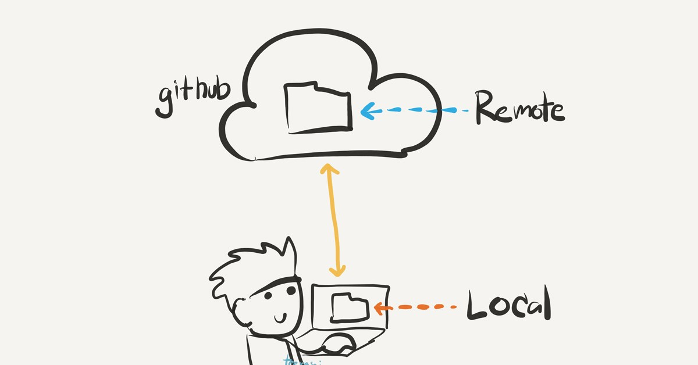
Today we will be using Git which is a distributed version control system.

Slide 23
Hands-On Git.
28 of July 2021
By Luisa Pinto
www.footasylum.com

Slide 24
Install Git
Git for All Platforms
git-scm.com Azure DevOps azure.microsoft.com/en-gb/services/devops/ GitHub Desktop
desktop.github.com
www.footasylum.com
Ref. training.github.com/downloads/github-git-cheat-sheet/

Slide 25
Configure Tooling.
Configure user information for all local repositories
$ git config --global user.name "[name]"
Sets the name you want attached to your commit transactions
$ git config --global user.email "[email address]"
Sets the email you want attached to your commit transactions
$ git config --global color.ui auto
Enables helpful colorization of command line output
www.footasylum.com
Ref. training.github.com/downloads/github-git-cheat-sheet/

Slide 26
Git Dictionary.
git: an open source, distributed version-control system
GitHub, AzureDevOps: platforms for hosting and collaborating on Git repositories
commit: a Git object, a snapshot of your entire repository compressed into a SHA
branch: a lightweight movable pointer to a commit
clone: a local version of a repository, including all commits and branches
remote: a common repository on GitHub that all team members use to exchange their changes
fork: a copy of a repository on GitHub owned by a different user
pull request: a place to compare and discuss the differences introduced on a branch with reviews, comments, integrated tests, and more
HEAD: representing your current working directory, the HEAD pointer can be moved to different branches, tags, or commits when using git checkout
www.footasylum.com
Ref. training.github.com/downloads/github-git-cheat-sheet/

Slide 27
Create Repositories.
A new repository can either be created locally, or an existing repository can be cloned.
When a repository was initialized locally, you have to push it to GitHub afterwards.
$ git init
The git init command turns an existing directory into a new Git repository inside the folder you are running this command.
After using the git init command, link the local repository to an empty GitHub repository using the following command:
$ git remote add origin [url]
Specifies the remote repository for your local repository. The url points to a repository on GitHub.
$ git clone [url]
Clone (download) a repository that already exists on GitHub, including all of the files, branches, and commits
www.footasylum.com
Ref. training.github.com/downloads/github-git-cheat-sheet/

Slide 28
The .gitignore file.
Sometimes it may be a good idea to exclude files from being tracked with Git.
This is typically done in a special file named .gitignore.
You can find helpful templates for .gitignore files at github.com/github/gitignore.
www.footasylum.com
Ref. training.github.com/downloads/github-git-cheat-sheet/

Slide 29
Make changes.
Browse and inspect the evolution of project files
$ git log
Lists version history for the current branch
$ git log --follow [file]
Lists version history for a file, beyond renames (works only for a single file)
$ git diff [first-branch]...[second-branch]
Shows content differences between two branches
$ git show [commit]
Outputs metadata and content changes of the specified commit
$ git add [file]
Snapshots the file in preparation for versioning
$ git commit -m "[descriptive message]"
Records file snapshots permanently in version history
www.footasylum.com
Ref. training.github.com/downloads/github-git-cheat-sheet/

Slide 30
Synchronize changes.
Synchronize your local repository with the remote repository on GitHub.com
$ git fetch
Downloads all history from the remote tracking branches
$ git merge
Combines remote tracking branches into current local branch
$ git push
Uploads all local branch commits to GitHub
$ git pull
Updates your current local working branch with all new commits from the corresponding remote branch on GitHub. git pull is a combination of git fetch and git merge
www.footasylum.com
Ref. training.github.com/downloads/github-git-cheat-sheet/

Slide 31
Redo commits
Erase mistakes and craft replacement history
$ git reset [commit]
Undoes all commits after [commit], preserving changes locally
$ git reset --hard [commit]
Discards all history and changes back to the specified commit
www.footasylum.com
Ref. training.github.com/downloads/github-git-cheat-sheet/

Slide 32
Branching Strategy.
Team-oriented Imagine an organization with a large website. The design teams uses the repo to track design documents. Whereas the web development team makes changes only in the website files.
Team-member oriented
Each team member works on their own branch. When their work is ready they merge it to the master.
Feature oriented
Each feature that is added to an application is developed in a separate branch until it is ready to be merged into the master.
Stage-oriented Branches are organised per development stage. Typically there is a ”development” branch where everyone works, and a “master” branch with the final product.
Often Feature-oriented and Stage-oriented are used simultaneously. Article: www.cloudbees.com/blog/branching-strategy
www.footasylum.com

Slide 33
Working with Branches.
Branches are an important part of working with Git. Any commits you make will be made on the branch you’re currently “checked out” to. Use git status to see which branch that is.
$ git branch [branch-name]
Creates a new branch
$ git checkout [branch-name]
Switches to the specified branch and updates the working directory
$ git merge [branch]
Combines the specified branch’s history into the current branch. This is usually done in pull requests, but is an important Git operation.
$ git branch -d [branch-name]
Deletes the specified branch
www.footasylum.com
Ref. training.github.com/downloads/github-git-cheat-sheet/

Slide 34
Rewiring History.
Change the history of your repositories.
$ git commit --ammend
It is the most convenient way to modify the most recent commit.
$ git rebase
Moves or combines a sequence of commits to a new base commit.
$ git rebase
Same as rebase, but runs it interactivly.
Article: https://www.atlassian.com/git/tutorials/rewriting-history/git-rebase
www.footasylum.com
Ref. training.github.com/downloads/github-git-cheat-sheet/

Slide 35
Learn More.
Git Online Book
https://git-scm.com/book/en/v2
Git Pro Free Kindle Book https://www.amazon.co.uk/Pro-Git-Scott-Chacon-ebook/
Git Free Course
https://classroom.udacity.com/courses/ud123
GitHub Free Course
https://classroom.udacity.com/courses/ud775
Azure DevOps www.pluralsight.com/browse/cloud-computing/azure/app-development/devops
Command Line & Git https://www.learnenough.com/courses
www.footasylum.com

Slide 36
Thank You.
Feel free to ask questions at anytime. Even after the workshop. Get in touch when/if you face issues using Git, GitHub or another platform. I love a challenge, helping and learning with others!
www.footasylum.com

